Slide 1
Pediatric response to oblique loading in aircraft seats with standard and inflatable seat belts
Julie Mansfield, PhD & John Bolte IV, PhD
The Ohio State University
Collaborators: Amanda Taylor (FAA), Aditya Belwadi (CHOP), Hans Hauschild (MCW)

Slide 2

CChIPS:
Center for Child Injury Prevention Studies

Slide 3
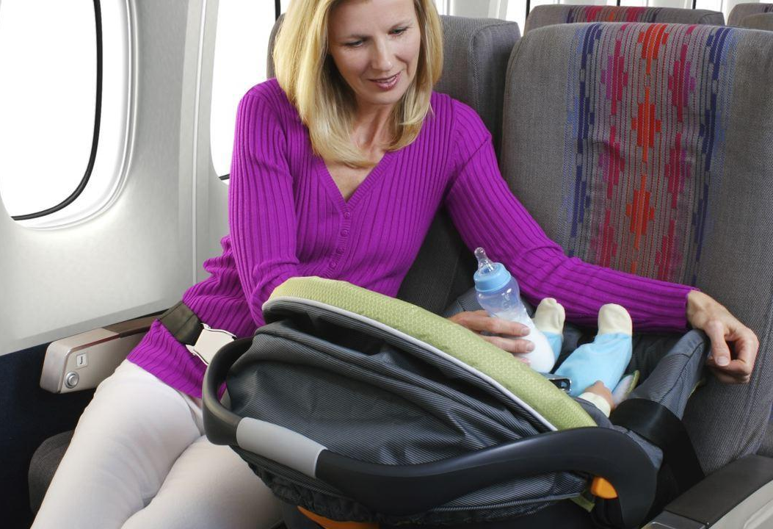
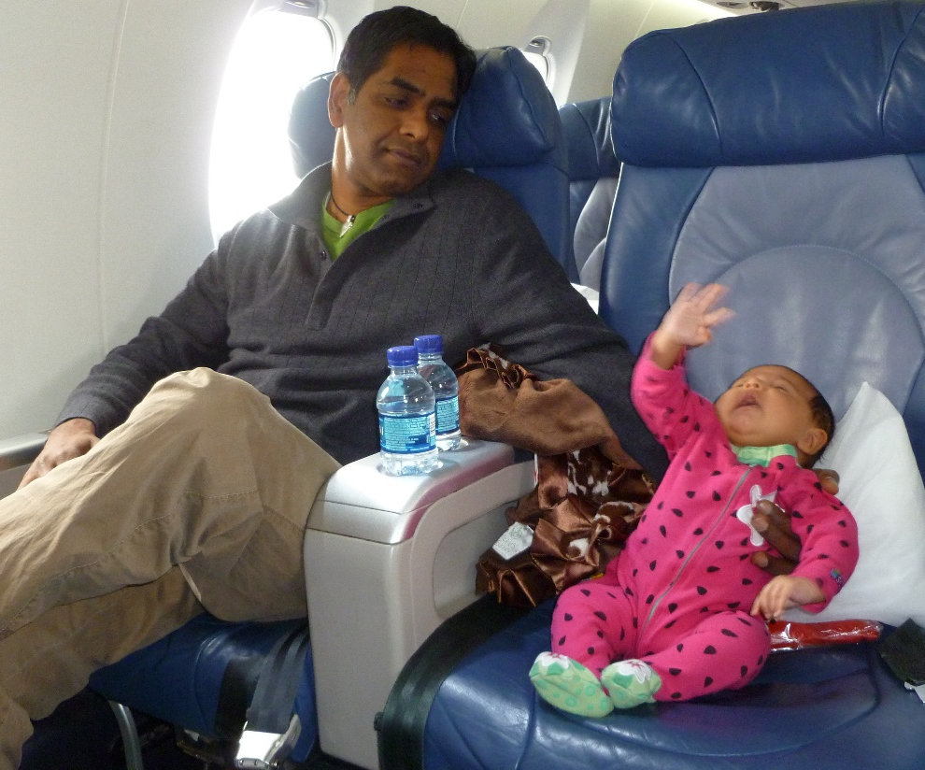
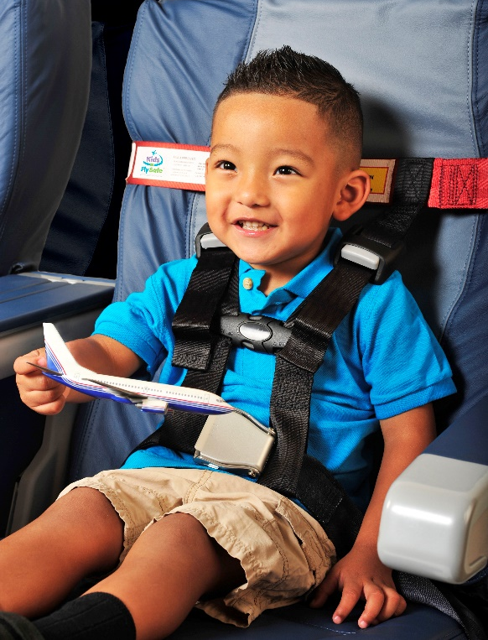
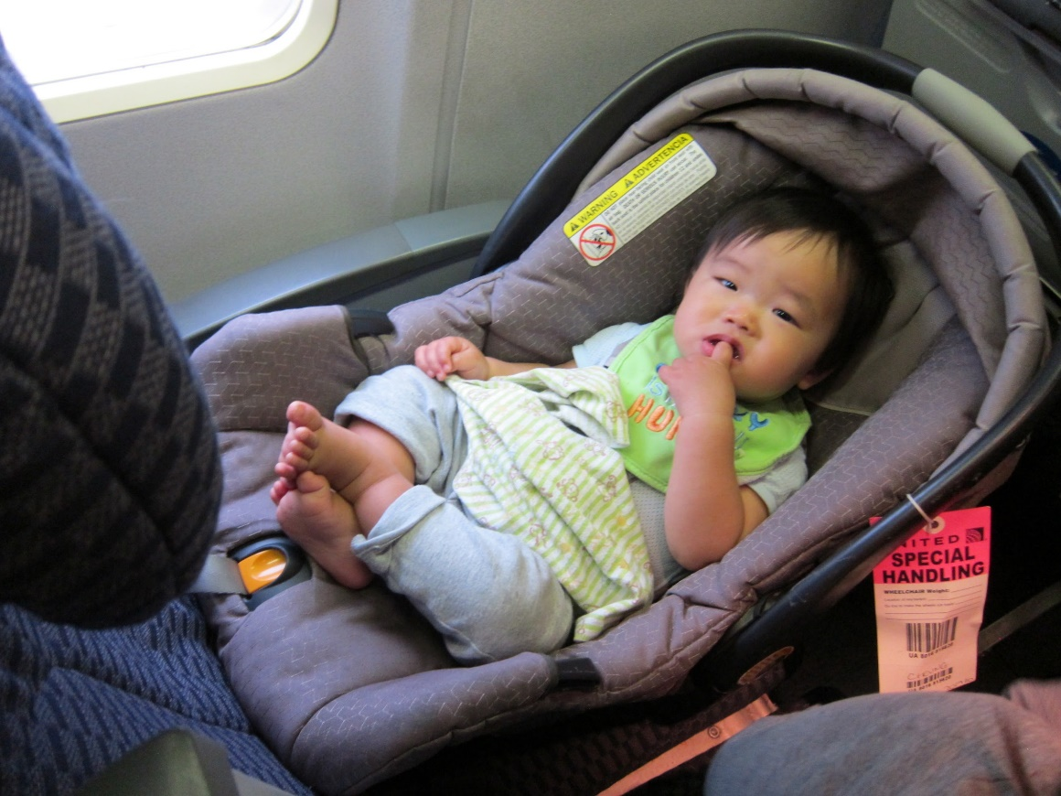
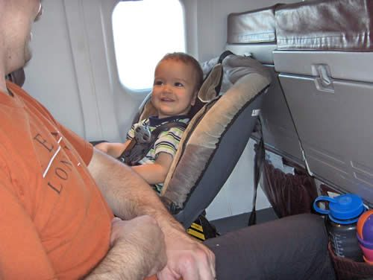

Slide 4
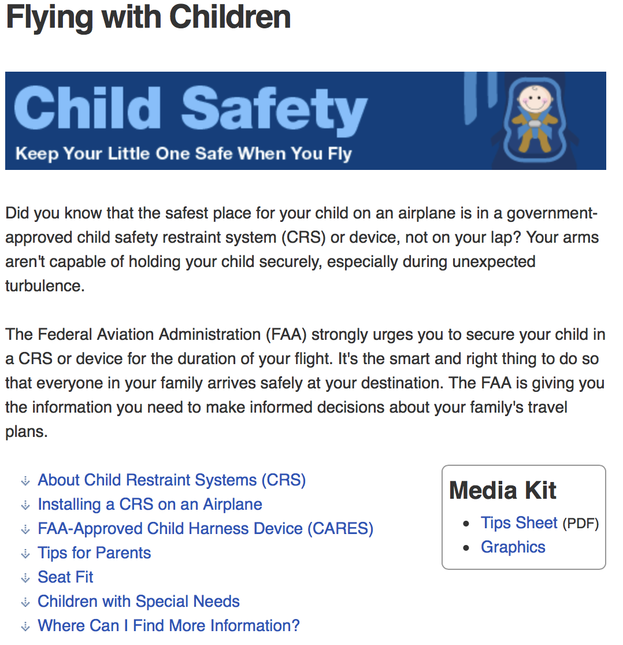
Background
https://www.faa.gov/travelers/fly_children/

Slide 5
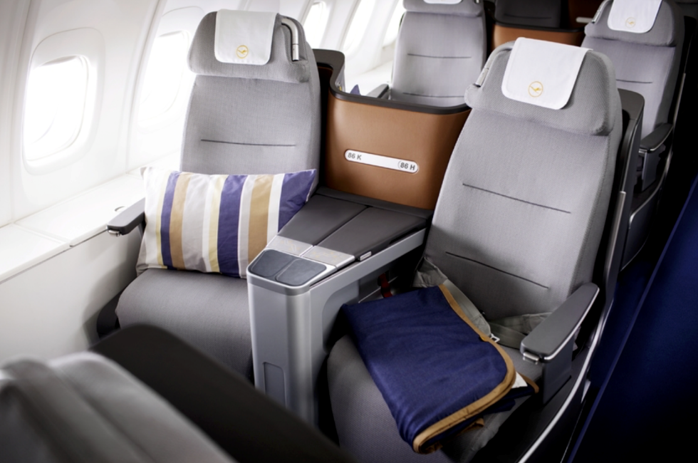
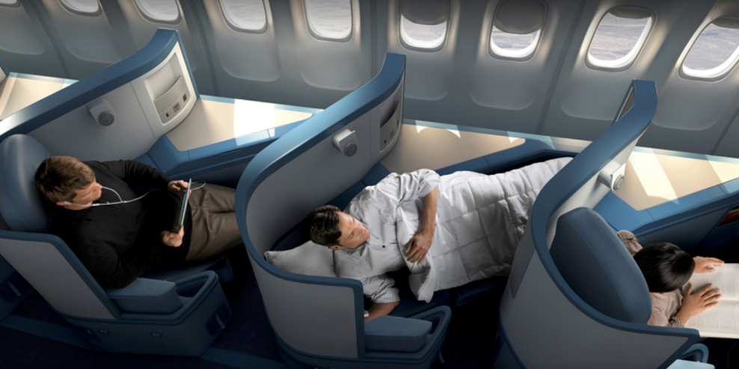
Background
CRS Regulations –
  Inversion test to ensure occupant is contained during turbulence
  FMVSS 213: CRS are crashworthy in frontal crash scenario
Adult seating is evolving:
  Seats oriented at oblique angles
  Inflatable lap and/or shoulder belts

Slide 6
Broad goals
Inform policies and regulations of the FAA regarding Child Restraint System (CRS) use on aircraft with obliquely oriented passenger seats and/or inflatable seat belts.
Positive outcomes could allow the FAA to better accommodate families and advise best practices for families traveling with children in CRS.

Slide 7

Specific Aims
To determine differences in pediatric occupant response for:
Aircraft seats oriented at 30° vs. 45° from the aircraft’s centerline
Standard aircraft lap belts vs. deactivated inflatable lap belts
0°
30°
45°

Slide 8
Previous testing
2015-2016 CChIPS Study
  Aditya Belwadi (CHOP) and Hans Hauschild (MCW)
Evaluate durability of rear-facing (RF) CRS and forward-facing (FF) CRS installed with inflatable seatbelts under static deployment

Slide 9
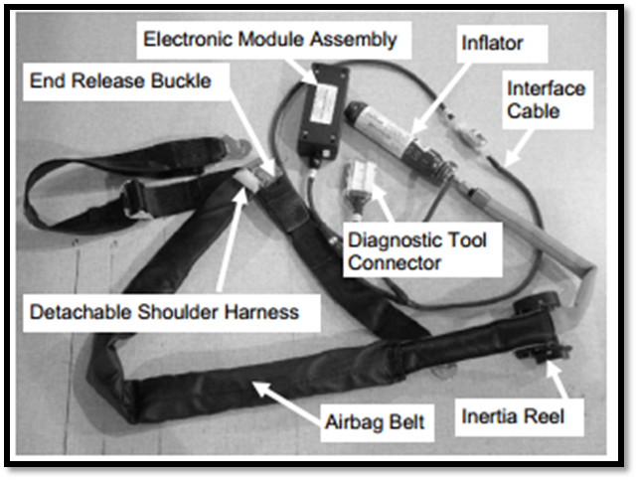
Previous testing
2015-2016 CChIPS Study
  Aditya Belwadi (CHOP) and Hans Hauschild (MCW)
Evaluate durability of rear-facing (RF) CRS and forward-facing (FF) CRS installed with inflatable seatbelts under static deployment
AMSAFE Aviation Inflatable Restraint (AAIR)

Slide 10
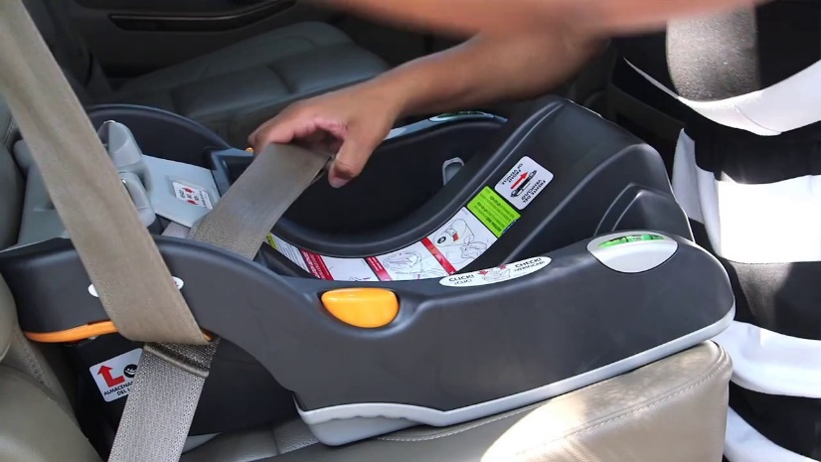
Previous testing
2015-2016 CChIPS Study
  Aditya Belwadi (CHOP) and Hans Hauschild (MCW)
Evaluate durability of rear-facing (RF) CRS and forward-facing (FF) CRS installed with inflatable seatbelts under static deployment
  RF CRS could not be installed properly
    Inflatable belt was too thick to route through base
    Tested without base
    Seat deemed durable

Slide 11
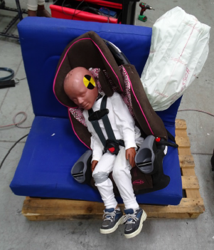
Previous testing
2015-2016 CChIPS Study
  Aditya Belwadi (CHOP) and Hans Hauschild (MCW)
Evaluate durability of rear-facing (RF) CRS and forward-facing (FF) CRS installed with inflatable seatbelts under static deployment
  RF CRS could not be installed properly
    Inflatable belt was too thick to route through base
    Tested without base
    Seat deemed durable
  FF CRS
    Properly installed
    Substantial lateral tipping
    Seat deemed durable

Slide 12
Methods: Sled series
Total of 43 tests
FAA Civil Aerospace Medical Institute, Oklahoma City
  Led and supervised by Amanda Taylor (FAA)
    Analysis, Part 1: Aditya Belwadi (CHOP), Hans Hauschild (MCW)
    Analysis, Part 2: John Bolte (OSU), Julie Mansfield (OSU)
16 G, 44 ft/sec triangular pulse (14 CFR Part 25.562)

Slide 13
Methods: Sled series
Total of 43 tests
FAA Civil Aerospace Medical Institute, Oklahoma City
  Led and supervised by Amanda Taylor (FAA)
    Analysis, Part 1: Aditya Belwadi (CHOP), Hans Hauschild (MCW)
    Analysis, Part 2: John Bolte (OSU), Julie Mansfield (OSU)
16 G, 44 ft/sec triangular pulse (14 CFR Part 25.562)
Variable | Conditions
Aircraft seat orientation angle | 30° or 45° from centerline
Type of lap belt | Deactivated inflatable or standard
CRS and ATD | RF (Q1), FF (HIII 3yo), or No CRS (HIII 3yo)
Adjacent structure | Wall, armrest, or no barrier

Slide 14
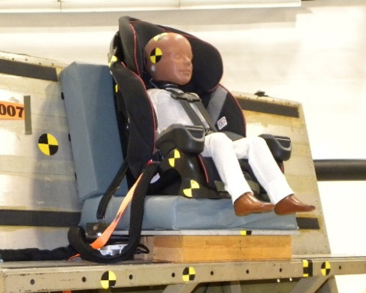
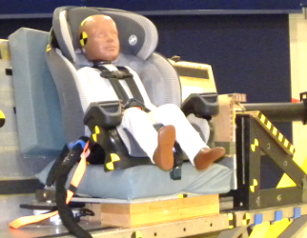
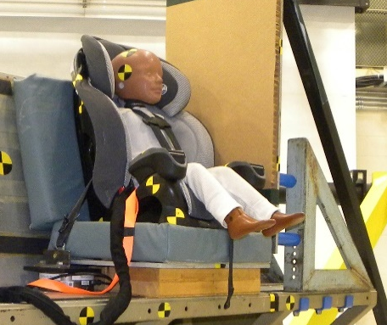
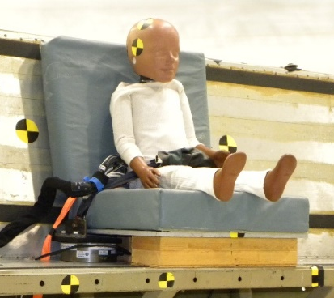
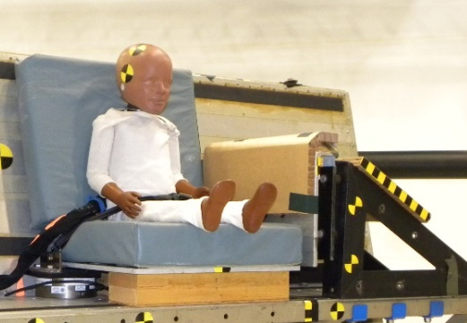
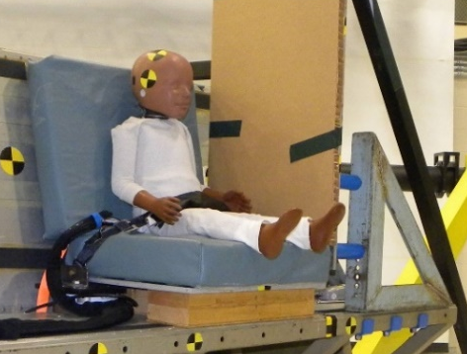
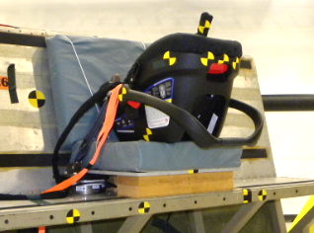
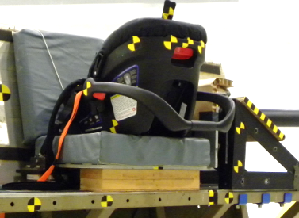
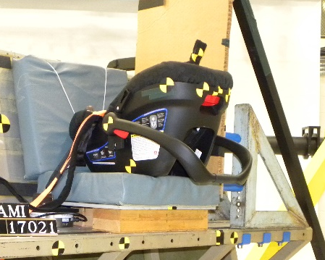
Methods: Sled series
No barrier
ARmrest
Wall
FF
No CRS
RF

Slide 15
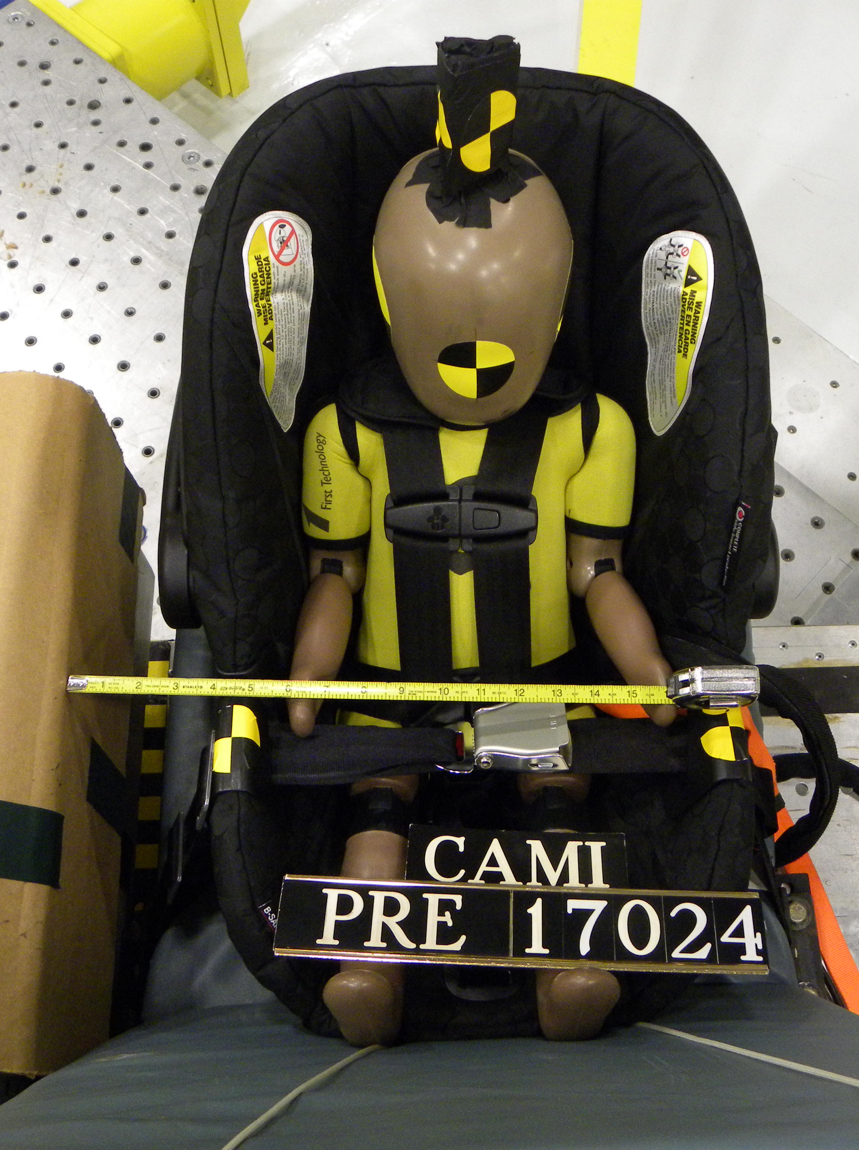
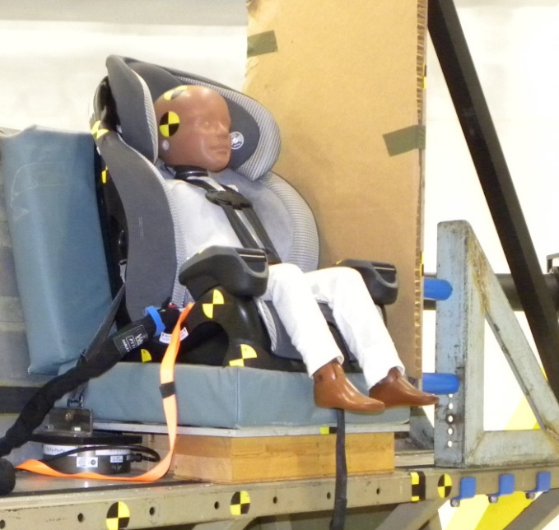
Methods:
ATD Instrumentation
Q1
  3a⍵ - head
  Tri-axial accels - pelvis
  6-axis upper neck load cell
  Thoracic potentiometer
HIII 3 year-old
  3a⍵ - head
  Tri-axial accels
    T1, T12,Chest & Pelvis
  6-axis upper neck load cell
  Thoracic potentiometer
  2-axis ASIS load cell
  2-axis Pubic load cell

Slide 16
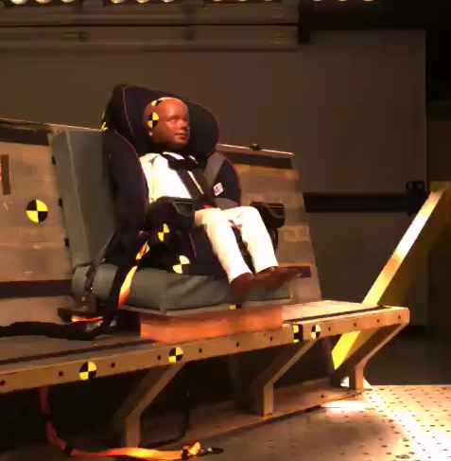
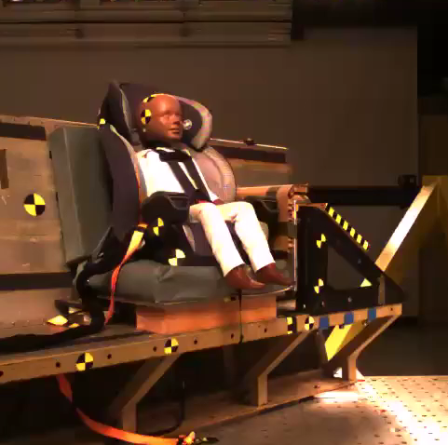
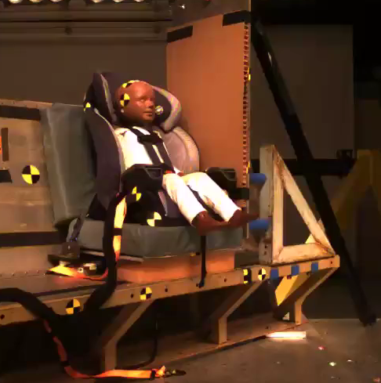
Results: 45°, FF CRS – HIII 3YO
No Barrier
Armrest
Wall

Slide 17
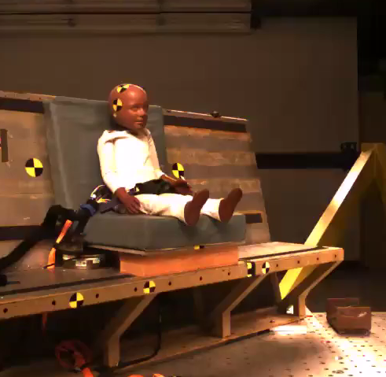
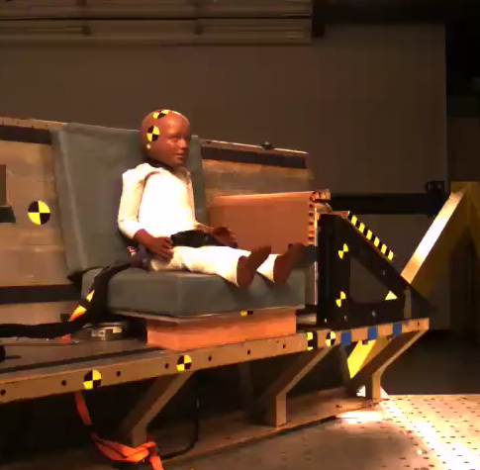
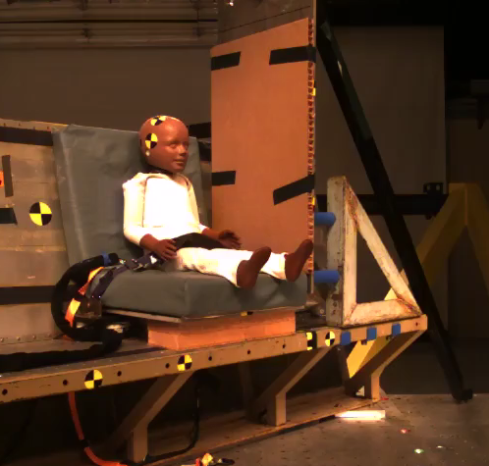
Results: 45°, No CRS - HIII 3YO
No Barrier
Armrest
Wall

Slide 18
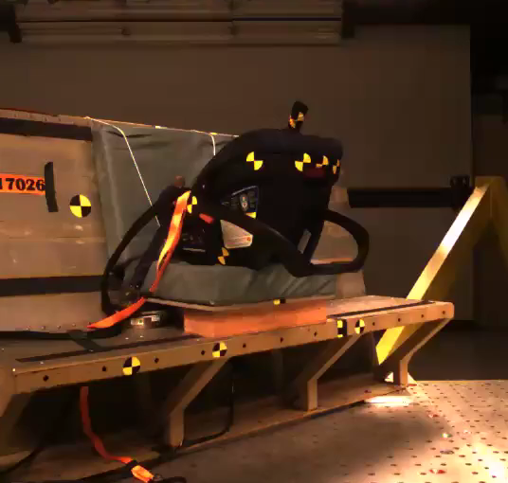
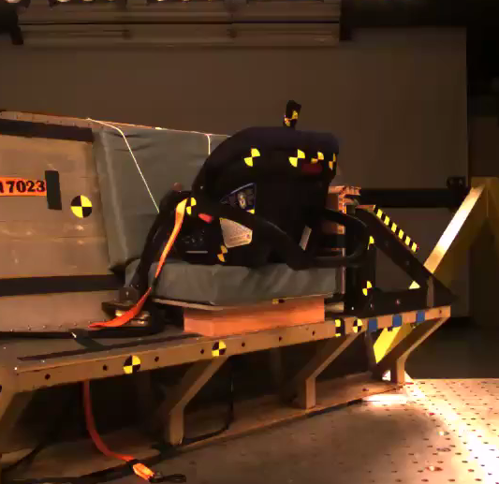
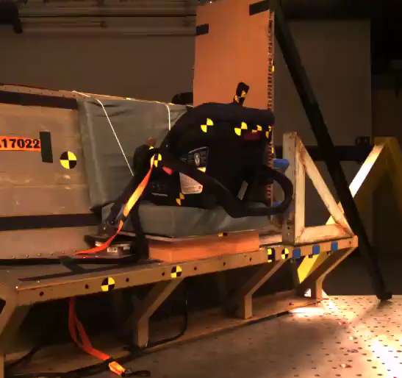
Results: 45°, RF CRS – Q1
No Barrier
Armrest
Wall

Slide 19
Specific Aims
To determine differences in pediatric occupant response for:
Aircraft seats oriented at 30° vs. 45° from the aircraft’s centerline
Standard lap belts vs. deactivated inflatable lap belts

Slide 20
Key
Belt type
St = Standard lap belt
In = Inflatable lap belt (deactivated)
Adjacent structures
NoB = No barrier
Arm = Armrest
Wal = Wall

Slide 21
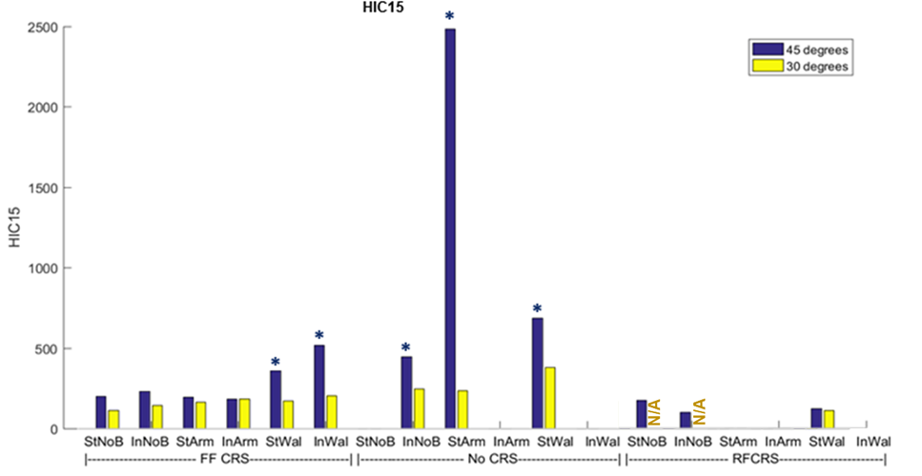
results: HIC 15
  IARVs
    568 for HIII 3YO
    389 for Q1
* Head strike

Slide 22
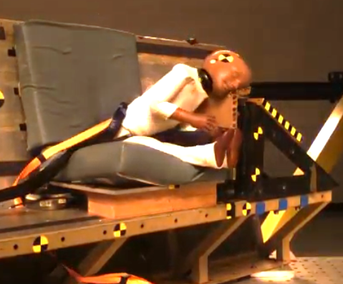
results: HIC 15
  IARVs
    568 for HIII 3YO
    389 for Q1
* Head strike

Slide 23
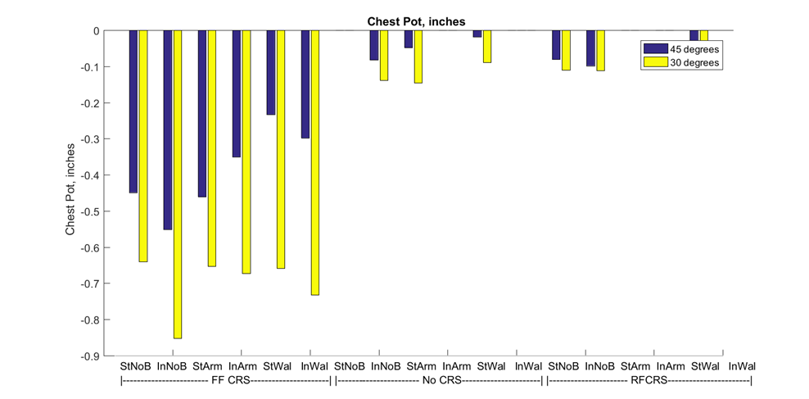
results: Thoracic deflection
  IARVs
    1.1” for HIII 3YO
    0.9” for Q1

Slide 24
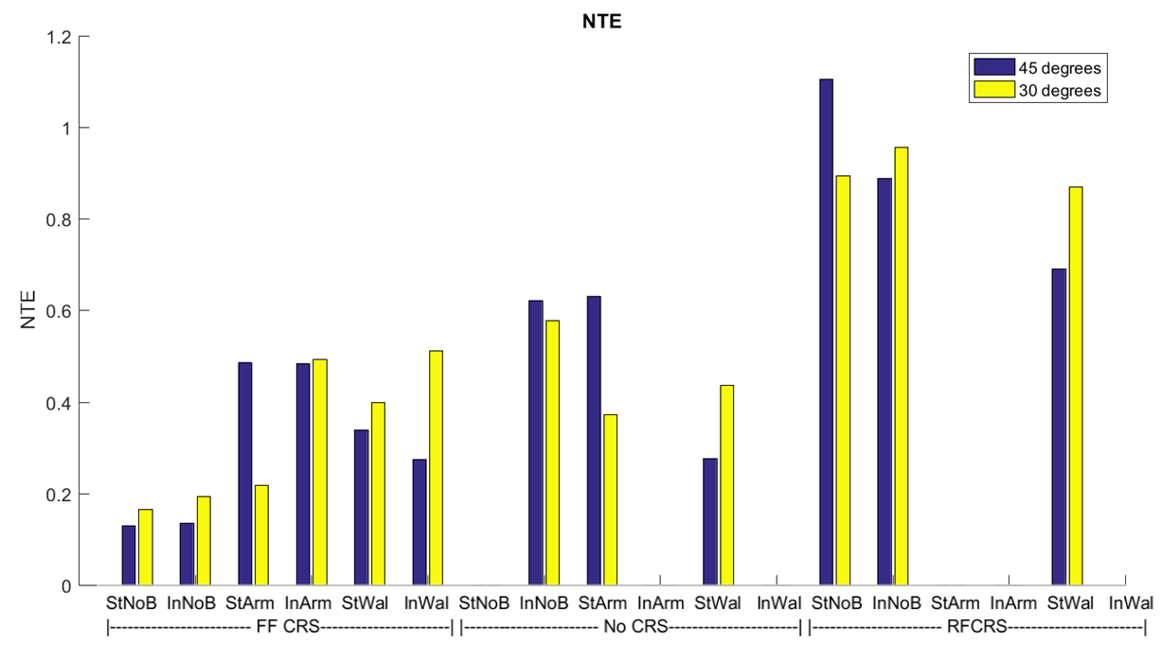
results: Neck Injury Criterion (N_{te})
  IARV
    1.0 for all

Slide 25
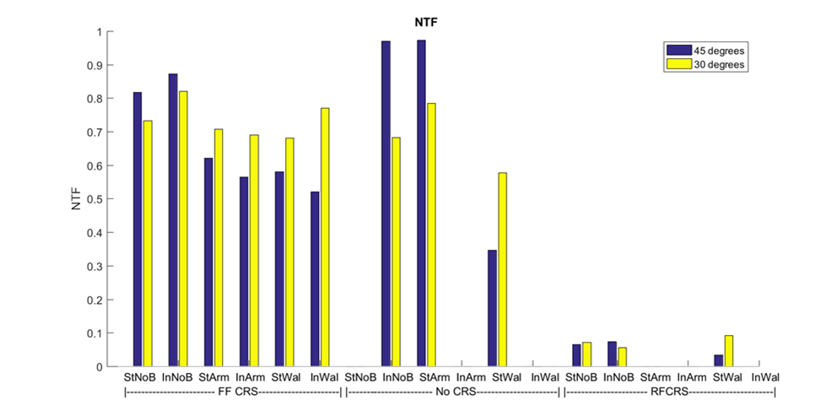
results: Neck Injury Criterion (N_{tf})
  IARV
    1.0 for all

Slide 26
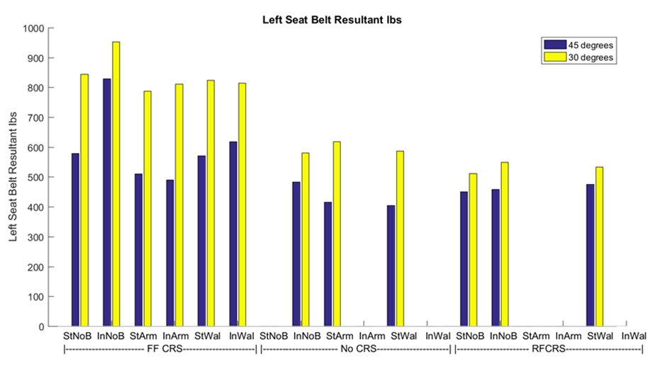
results: Left Belt force

Slide 27
Specific Aims
To determine differences in pediatric occupant response for:
Aircraft seats oriented at 30° vs. 45° from the aircraft’s centerline
Standard lap belts vs. deactivated inflatable lap belts

Slide 28
Specific Aims
To determine differences in pediatric occupant response for:
Aircraft seats oriented at 30° vs. 45° from the aircraft’s centerline
Standard lap belts vs. deactivated inflatable lap belts
*Results presented for 45° tests only*

Slide 29
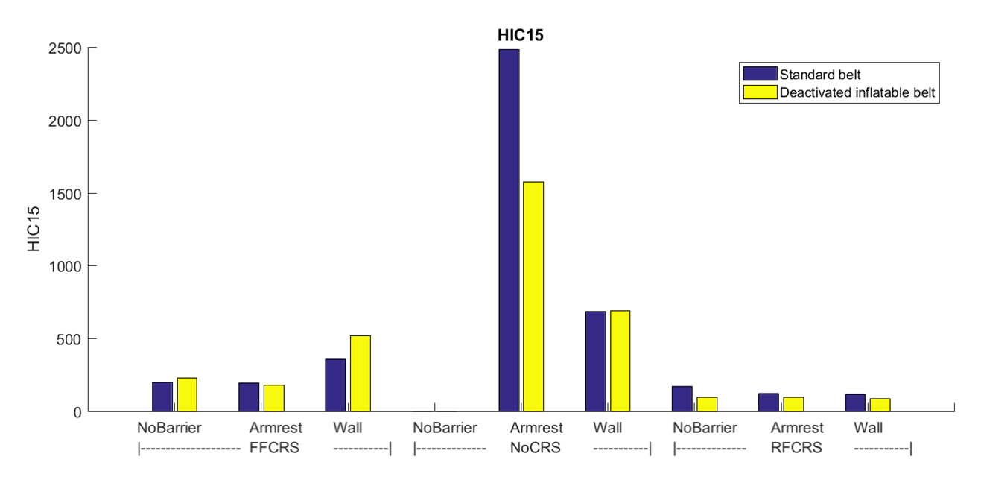
results: HIC 15
  IARVS
    568 for HIII 3YO
    389 for Q1

Slide 30
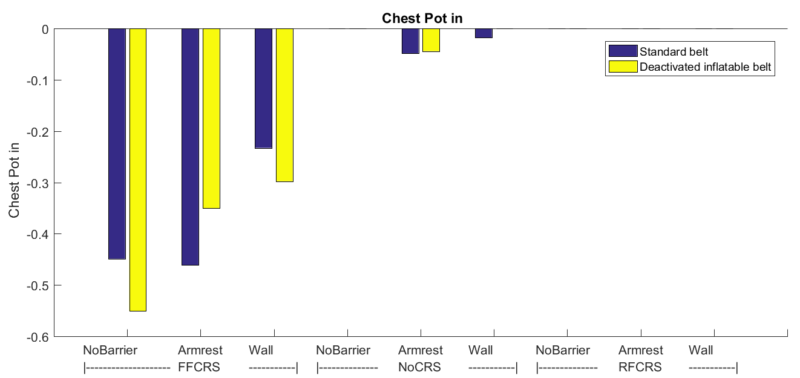
results: Thoracic deflection
  IARVs
    1.1” for HIII 3YO
    0.9” for Q1

Slide 31
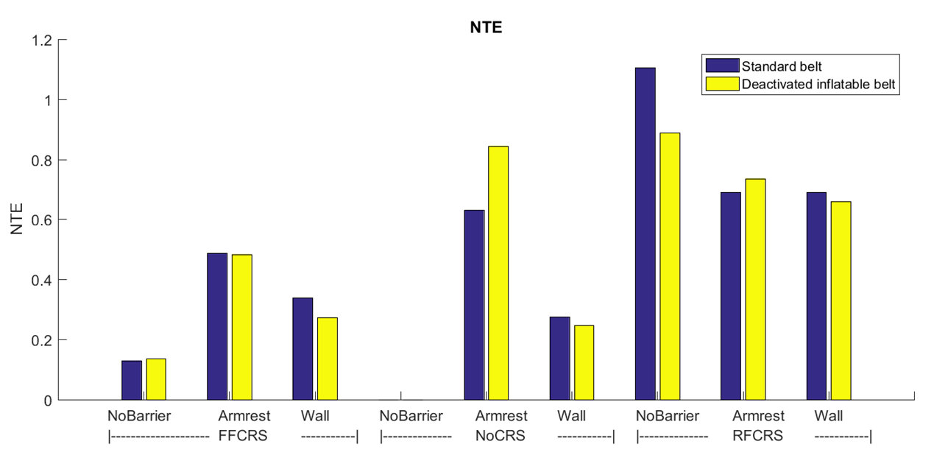
results: Neck Injury Criterion (N_{te})
  IARV
    1.0 for all

Slide 32
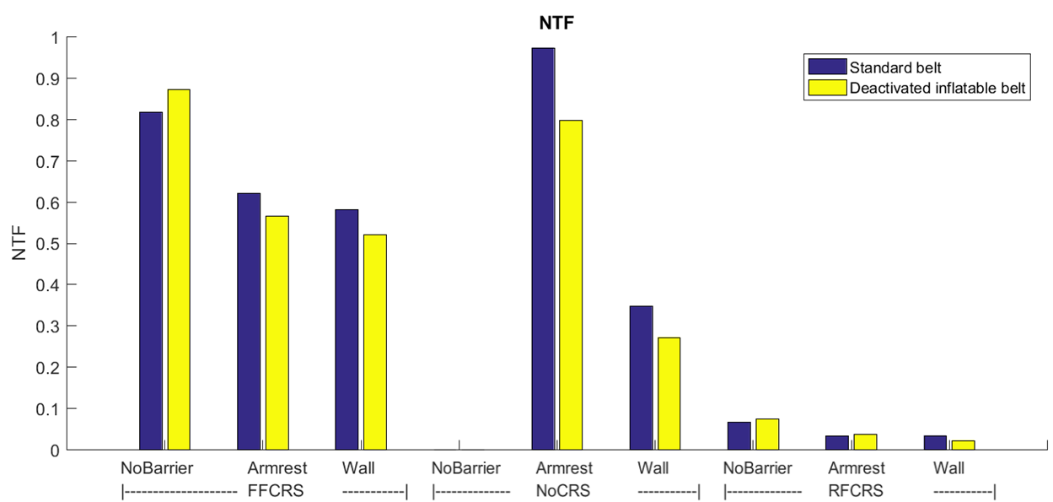
results: Neck Injury Criterion (N_{tf})
  IARV
    1.0 for all

Slide 33
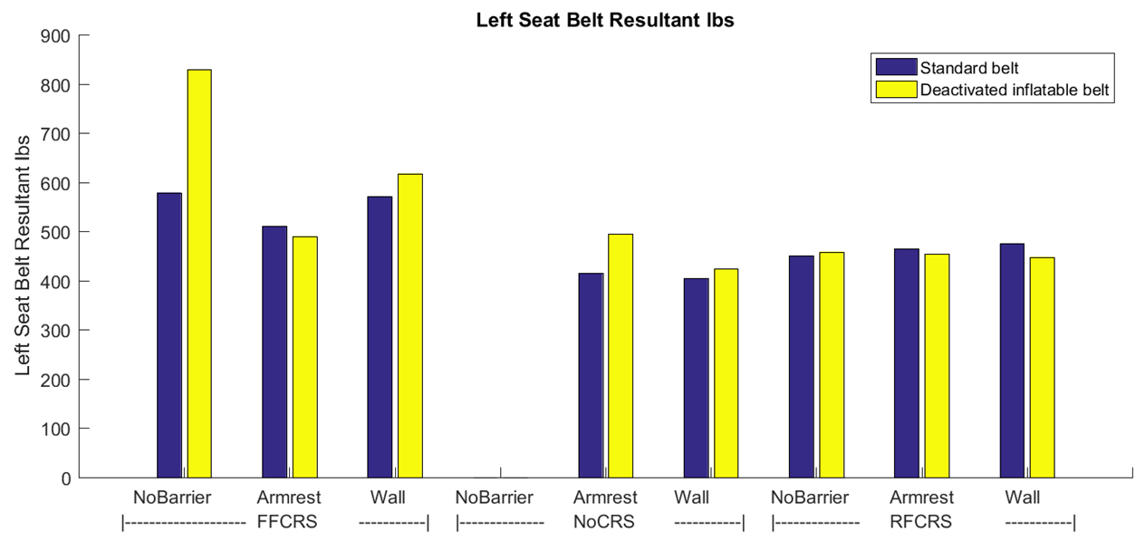
results: Left Belt force

Slide 34
Conclusions
Aim 1 – 30° vs. 45° oblique angle
  Chest deflection
    Greater for 30º than 45º conditions
  Neck Injury Criteria
    N_{TE} & N_{TF} – Similar across 30º and 45º
  HIC15
    Head strikes in several 45° conditions
    No head strikes in 30° conditions
  Consider limiting the offset angle at which pediatric passengers can be seated, particularly when adjacent structures could pose the threat of head strikes.
Aim 2 – Standard vs. deactivated inflatable lap belts
  Issues installing RF CRS with base
  Once installed, similar performance across belt types

Slide 35
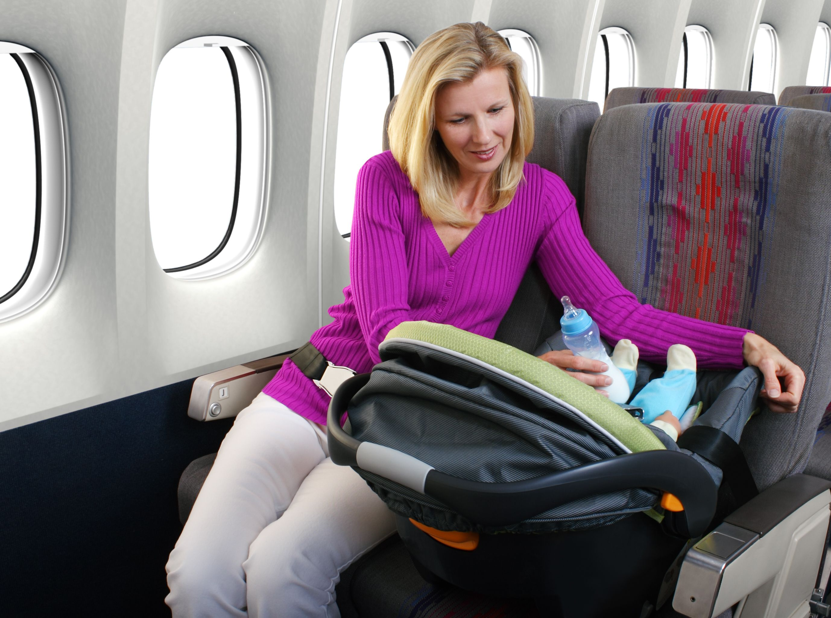
Conclusions
These data support the FAA’s recommendation to use CRS on aircraft whenever possible.
Benefits of rear-facing CRS are especially prominent when considering head containment and head protection.

Slide 36
Acknowledgements
Primary Mentor
  Amanda Taylor – FAA
Collaborators
  Aditya Belwadi – Children’s Hospital of Philadelphia
  Hans Hauschild – Medical College of Wisconsin
CChIPS Mentors
  Hyunjung Kwon – TRC Inc.
  Hiro Tanji – Takata
  Jerry Wang – Humanetics
  Eric Dahle – Evenflo/Goodbaby
OSU Students
  Colleen Harkins
  Sarah Shaffer
  Gina Gugliotta
  Abbey Barnette

Slide 37
Pediatric response to oblique loading in aircraft seats with standard and inflatable seat belts
Julie Mansfield, PhD & John Bolte IV, PhD
The Ohio State University
Collaborators: Amanda Taylor (FAA), Aditya Belwadi (CHOP), Hans Hauschild (MCW)

Slide 38
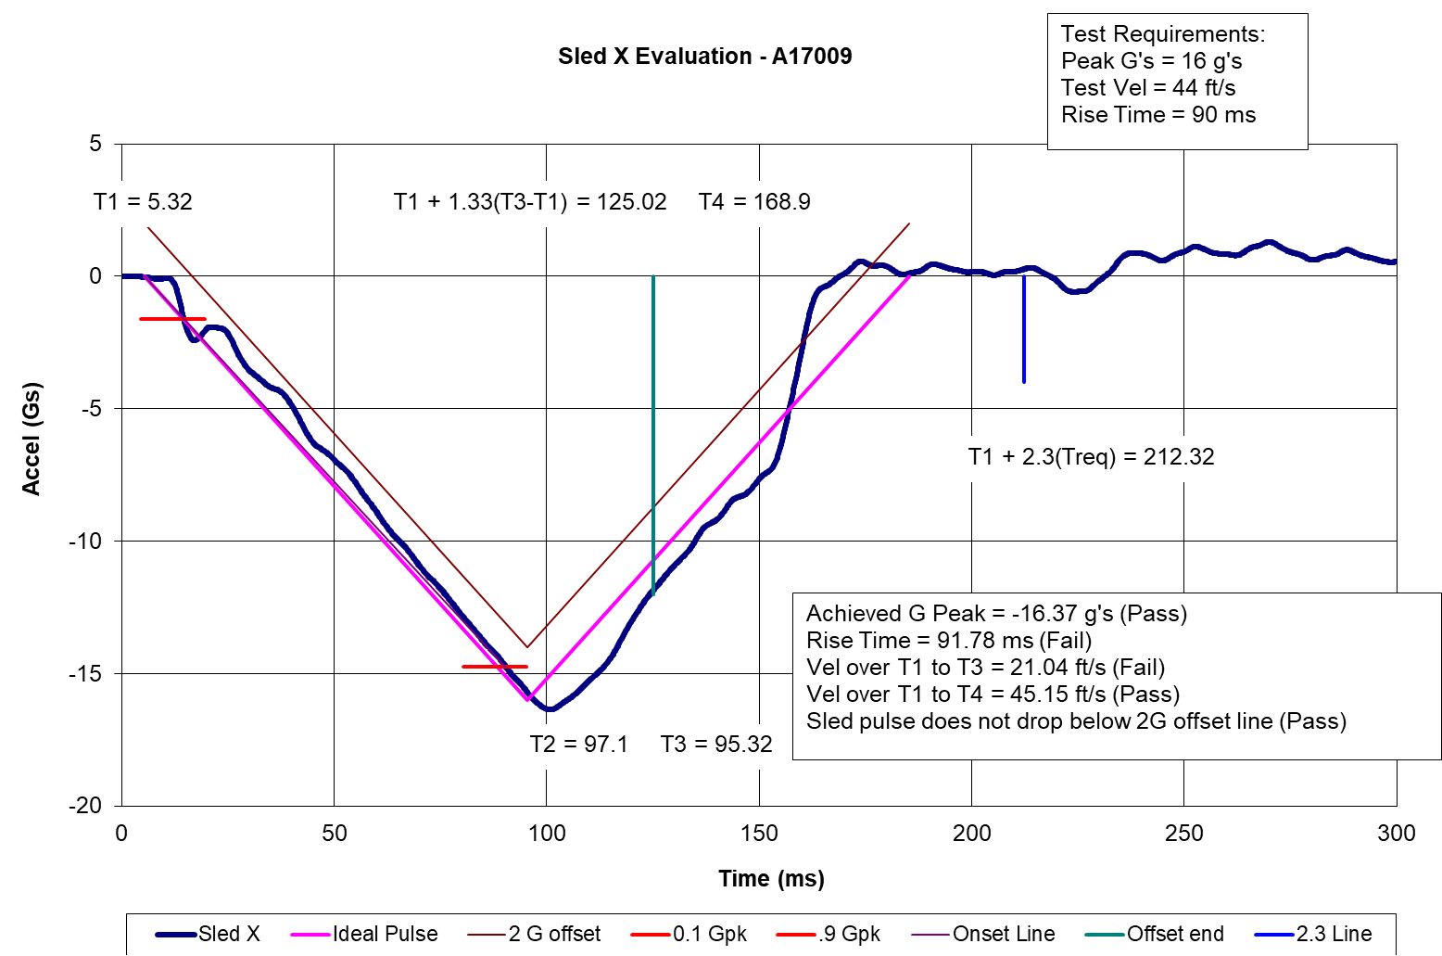
Sled pulse
16 G, 44 ft/sec triangular pulse (14 CFR Part 25.562)

Slide 39
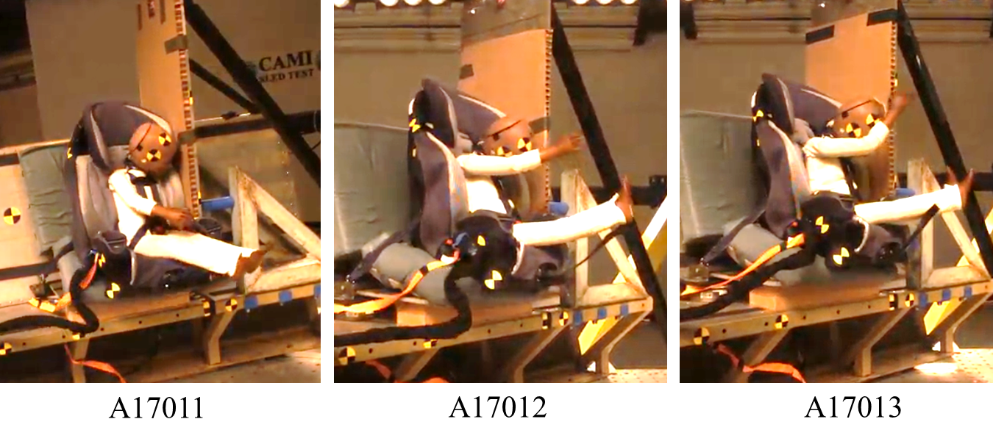
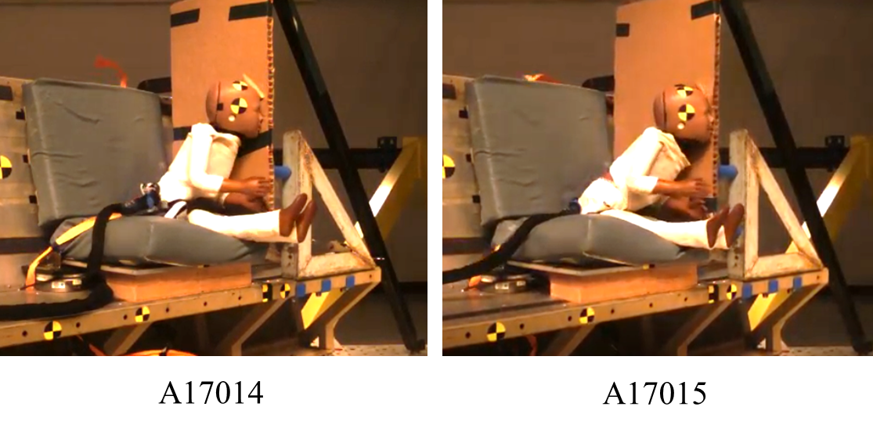
Head strikes

Slide 40
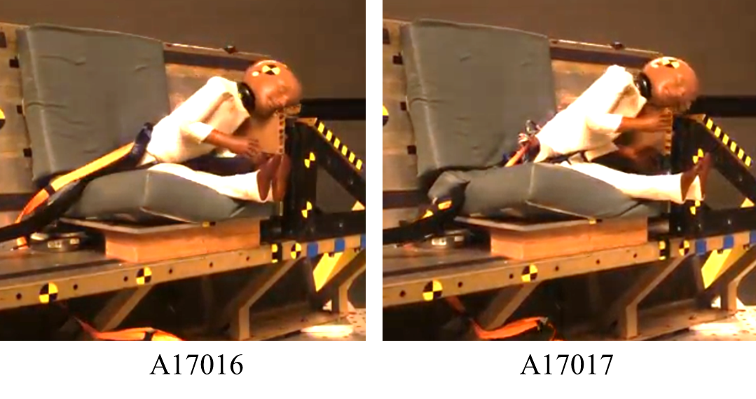
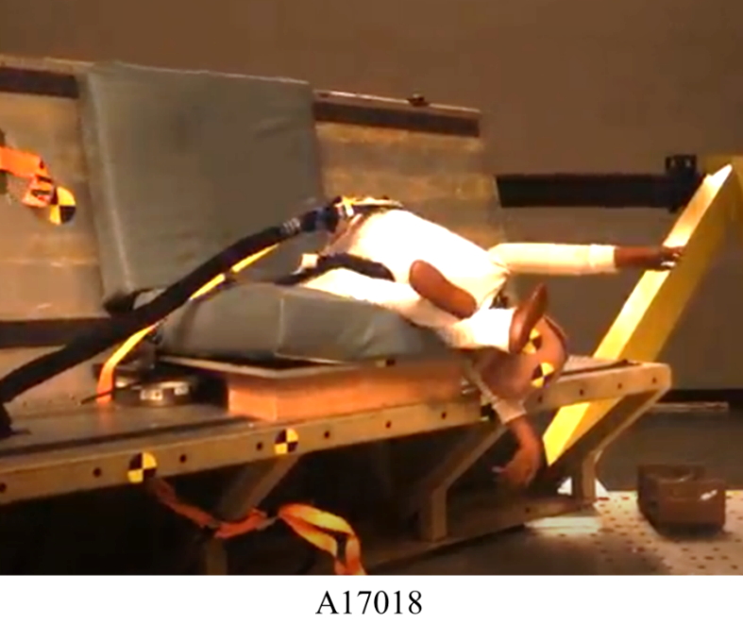
Head strikes

Slide 41
Test matrix: 30° tests

Slide 42
Test matrix: 45° tests

Slide 43
45° tests With head strikes

